Slide 1
Progressive Web Apps
Jeroen Overschie

Slide 2
Why

Slide 3
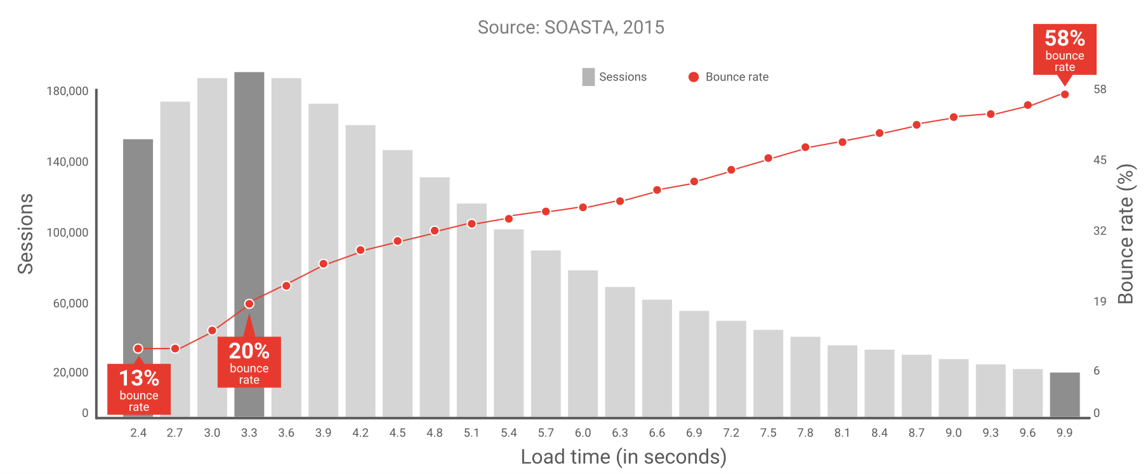
Your web-app should be fast.

Slide 4

40%
of users will bounce from sites that will take longer than 3 seconds to load
Source: https://developers.google.com/web/ilt/pwa/why-build-pwa

Slide 5

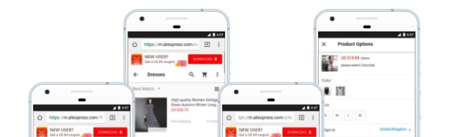
104%
more new users across all browsers; 82% increase in iOS conversion rate
2X
more pages visited per session per user across all browsers
74%
increase in time spent per session across all browsers
Upgraded their web-app to use PWA principles.
Monthly traffic: 666.50M

Slide 6
Users want PWA’s
What makes a webapp progressive?

Slide 7

PWA?

Slide 8


“Progressive Web Applications are web applications that [...] offer the user functionality such as working offline, push notifications, and device hardware access traditionally available only to native applications.”
Source: https://en.wikipedia.org/wiki/Progressive_web_applications

Slide 9
“Progressive Web Applications are web applications that [...] offer the user functionality such as working offline, push notifications, and device hardware access traditionally available only to native applications.”
Source: https://en.wikipedia.org/wiki/Progressive_web_applications

Slide 10

Web vs. Native
You are too slow !
Ouch!
Native used to win in a lot of ways:
Direct access to hardware
Offline functionality
Distributed via reliable app stores

Slide 11

Web vs. Native
I work offline too!
However! In the last years Web became more mature.
Lots of new API’s to talk to the hardware
Ability to cache website for offline usage
Push notifications, Add To Home Screen, etc.
Notes:
Web Apps don’t need an app store! Great.

Slide 12
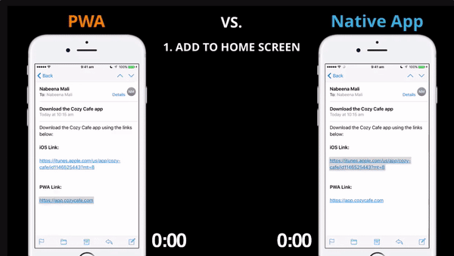

Slide 13


The Challenge
Browsers
Operating systems
Hardware

Slide 14
The Challenge
Fixed broadband, wifi or cellular?
Low-bandwidth or unreliable connections
Offline

Slide 15
PWA’s leverage new web API’s to make your webapp feel like native.

Slide 16
Tools for becoming progressive
Web API’s
Web Worker API
New core API’s facilitate a lot of new functionality
Service Worker API
Push API
Notifications API
Push-Notifications API
… there exist many API’s

Slide 17
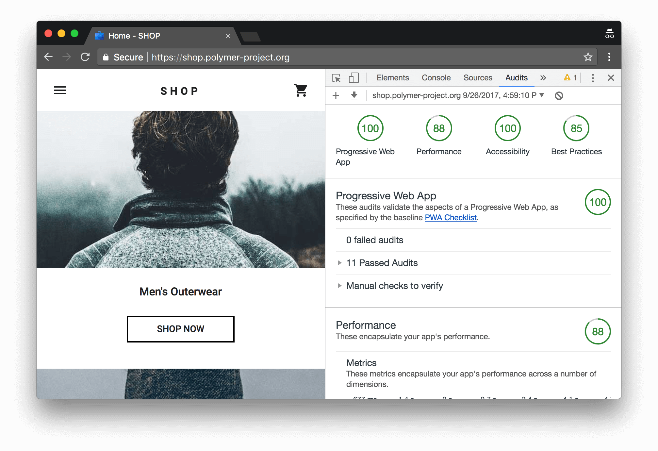

Tools for becoming progressive
Audit Tools
Lighthouse

Slide 18
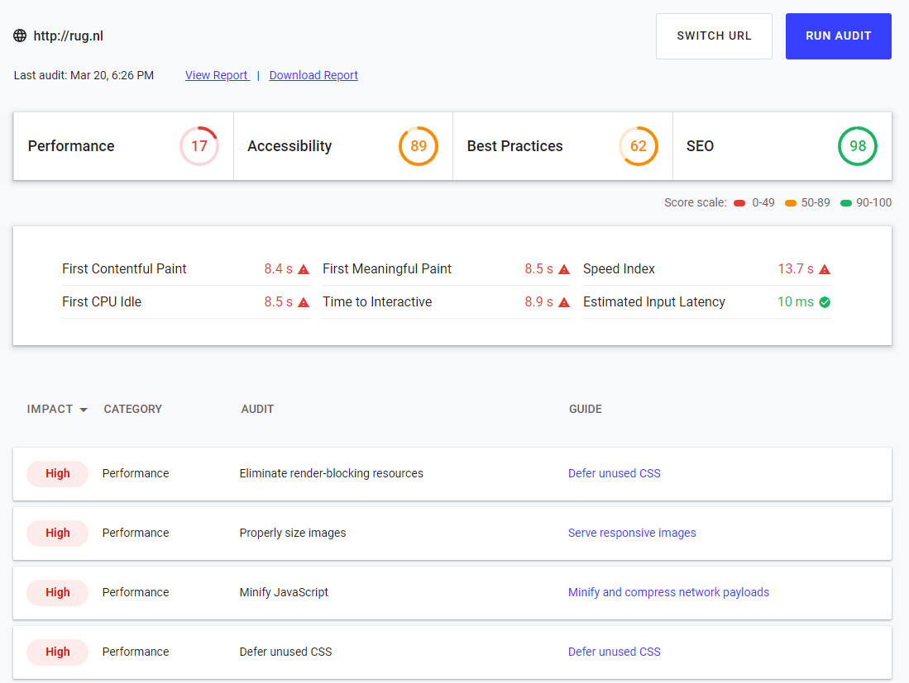
Tools for becoming progressive
Lighthouse

Slide 19
Tools for becoming progressive
Good practices

Slide 20
How
to become progressive

Slide 21
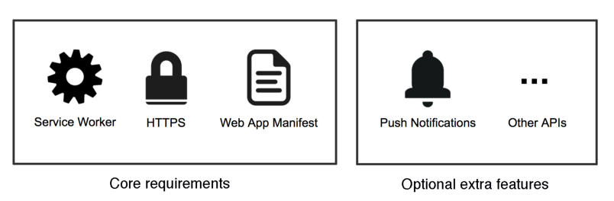
Becoming progressive
Core requirements
Optional extra features

Slide 22
Becoming Progressive
Serve over HTTPS
Service Worker
Web App Manifest
Offline
Optimisation:
Performance
Critical Rendering Path
Accelerated Mobile Pages (AMP)
Service Side Rendering (SSR)

Slide 23
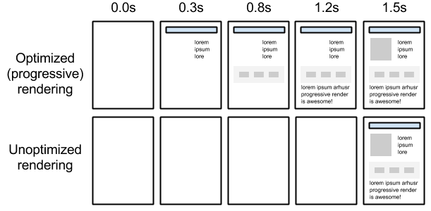
Critical Rendering Path
Render as fast as possible. Delay load of all non-critical content.
¹
¹ https://developers.google.com/web/fundamentals/performance/critical-rendering-path/

Slide 24
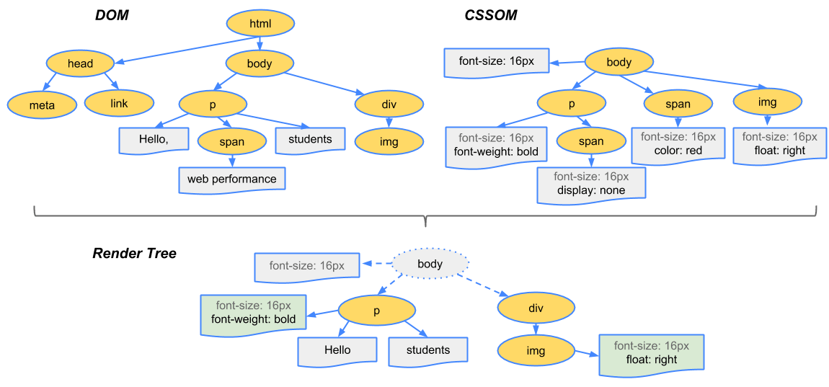
Critical Rendering Path
The DOM and CSSOM trees are combined to form the render tree.
Render tree contains only the nodes required to render the page.
Layout computes the exact position and size of each object.
The last step is paint, which takes in the final render tree and renders the pixels to the screen.
²
² https://developers.google.com/web/fundamentals/performance/critical-rendering-path/

Slide 25
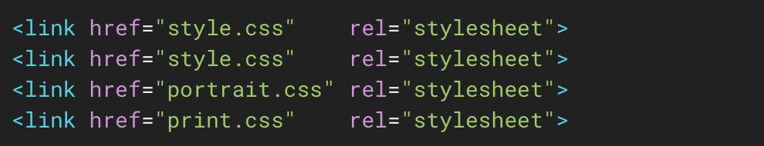
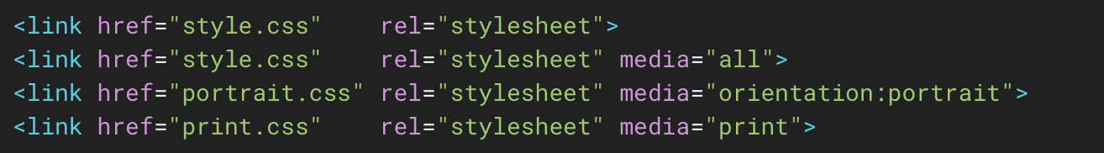
Critical Rendering Path
CSS loads in any case.
CSS only load on selected environments.

Slide 26
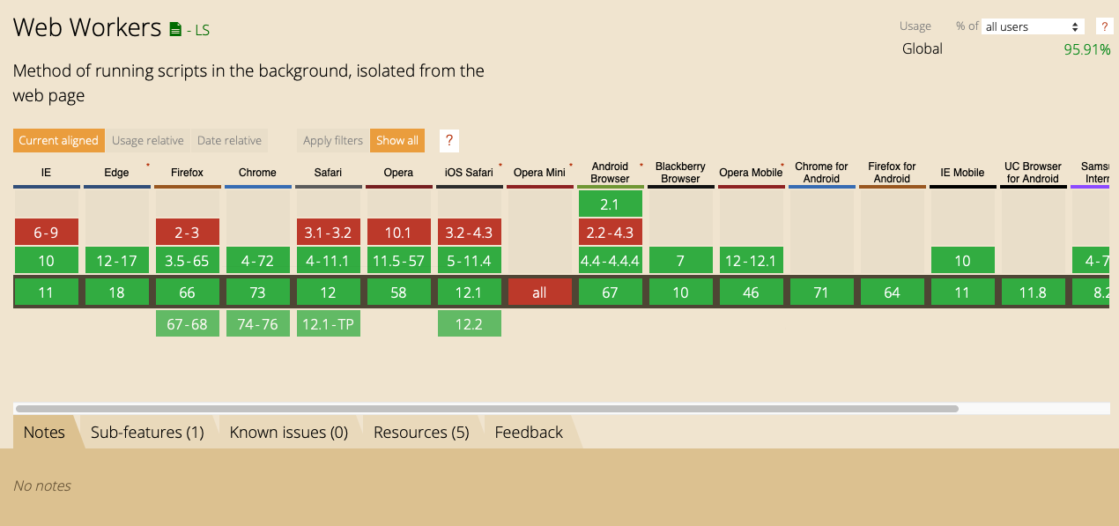
Web Workers

Slide 27
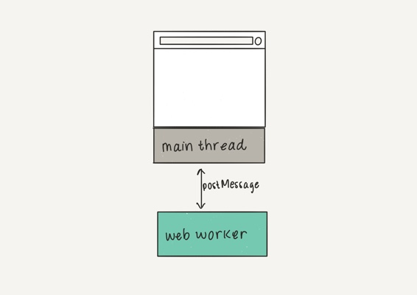
Web Workers

Slide 28
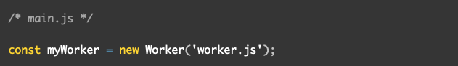
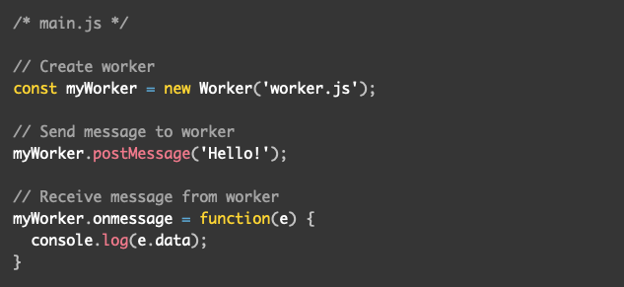
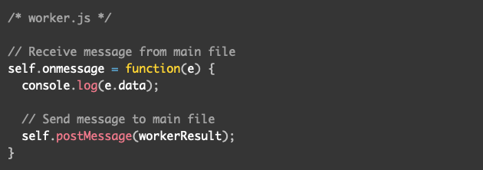
Web Workers

Slide 29
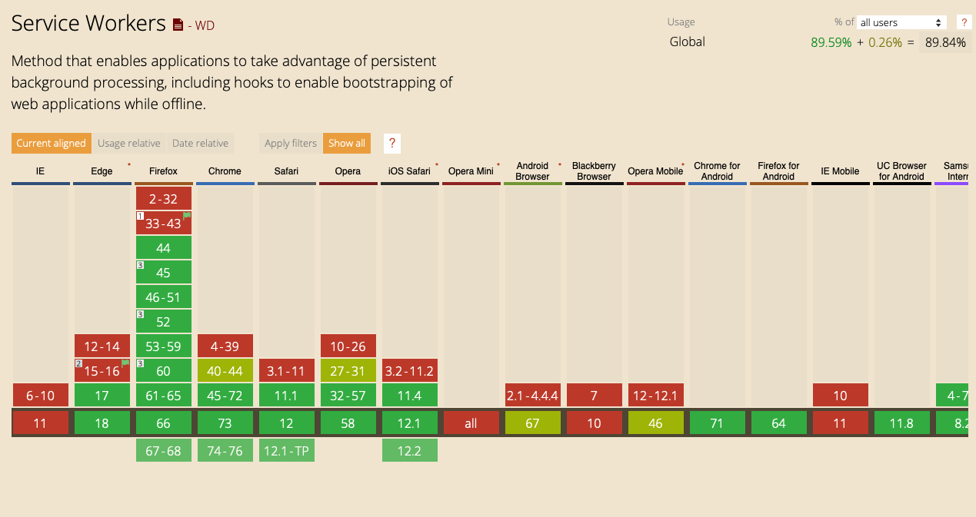
Service Workers

Slide 30
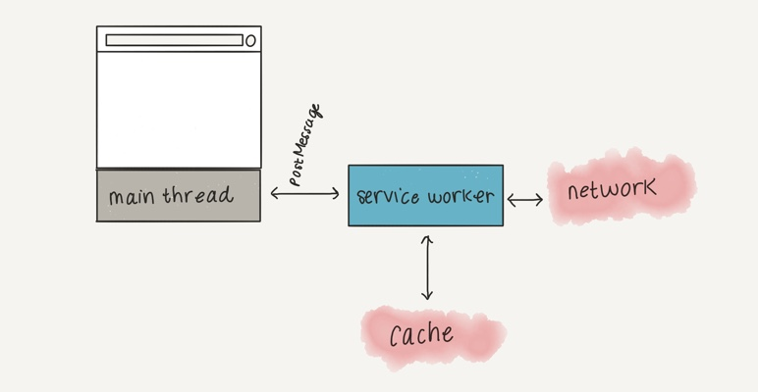
Service Workers

Slide 31


Demo
Tag along:
https://github.com/dunnkers/webeng-progressive-web-apps
Optimising images and using a web worker.

Slide 32

Stay ahead of the curve: learn PWA

Slide 33

Thanks!
Jeroen Overschie
https://github.com/dunnkers

